Slide 1

Human Development
Chapter 9

Slide 2
Defining Human Development
Psychologists define human development as physical and psychological changes that naturally occur across the life-span.
Key points:
  Development requires a change (e.g., growth)
  This change happens naturally

Slide 3
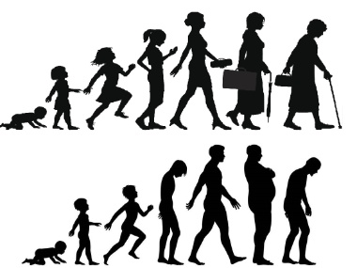
What is “development” across the lifespan?
Development – Age-related change
  Marked by both growth and decline
  Changes are not just physical

Slide 4
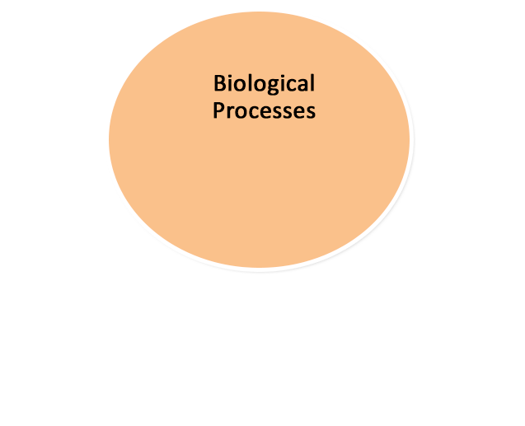
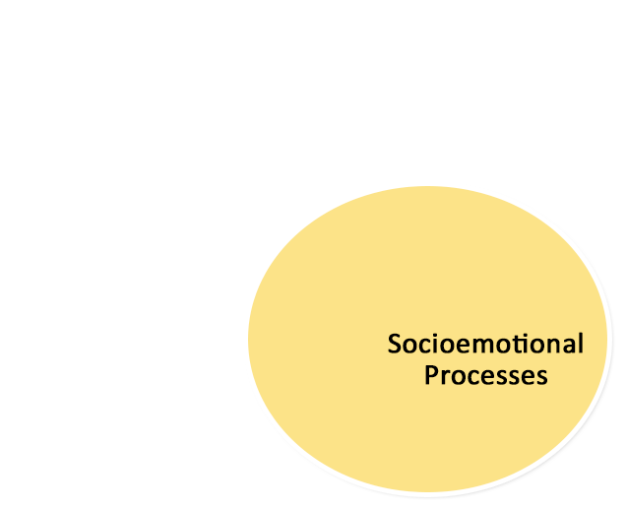
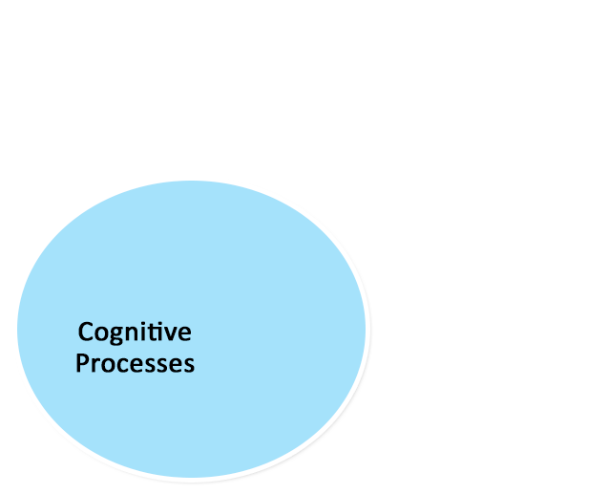
What is “development” across the lifespan?
- Physical Changes
- Puberty
- Menopause
- Thoughts
- Language
- Intelligence
- Attention
- Memory
- Relationships
- Emotions
- Personality
Biopsychosocial Approach

Slide 5
Recurring Issues in Human Development
Nature vs. Nurture
  Influence of heredity vs. environment
    Heredity == inherited genetic information
  Example: Are traits like intelligence, personality, etc. solely inherited from parents or is it due to how and where you were raised?

Slide 6
Nature vs. Nurture in Development
Nature – What is biologically inherited
Nurture – What is environmentally learned
Self? – Individuals take an active role in their own development
  Seek “optimal experiences”
  Going beyond hardships to exceed biological and environmental developmental trajectories

Slide 7

Resilience
An individual’s ability to recover or adapt from difficult times
  Can one still become and independent and capable adult after adversity?
Extreme example: Genie Wiley
  How was she able to develop in spite of childhood neglect?

Slide 8
Development: Research Methods
Assessing age-related differences vs. age changes
Cross-sectional designs
  Different people, of different ages, test at the same moment in time
  Typically, one compares averages or means of these age groups
  Simplest, most common design in aging/developmental research
  Only shows age-related differences
  Example: Does verbal intelligence differ between older and younger adults?

Slide 9
Cross-Sectional Example
John
Mary
Jim
IQ Assessed
In 2016
Verbal
IQ
June
Mike
Ellen
Young
Old
Age

Slide 10
Cross-Sectional Design Limitations
Cross-sectional designs are susceptible to cohort effects
  Differences could be due to differing generations
Cross-sectional designs do not measure change
  Cannot determine how individuals may have changed from Time 1 to Time 2, Time 2 to Time 3, or beyond

Slide 11
Development Research Methods
Assessing age-related differences vs. age changes
Longitudinal Designs
  Same people tested at different points in time
Typically, age is examined by comparing averages or means at different times (ages)
  Assess Intra-Individual Change
  Can explain how individuals change over time
  Example: Verbal IQ and age

Slide 12
Longitudinal Example
John
Mary
Jim
John
Mary
Jim
Verbal
IQ
John
Mary
Jim
1960
Young
1980
Middle-aged
2000
Old
Age

Slide 13
Issues with Longitudinal Designs
Expense
  15-20 + years worth of data is expensive to collect
    Contact participants, follow them through life changes
Time
  Takes much longer to collect data
Obsolescence
  Testing procedures evolve, tests change (e.g., IQ)
    Use dated tests? Or new ones? Comparison issues?

Slide 14
What kind of design???
Jackie
Majorie
Anita
Jackie
Majorie
Anita
Personality
Jackie
Majorie
Anita
1960
Young
1980
Middle-aged
2000
Old
Age

Slide 15
What kind of design???
Jack
Allison
Alfonse
Assessed
In 1995
Personality
Alex
Sarah
Tristian
Middle
Age
Old
Age
Age

Slide 16
Development Research Methods
Assessing age-related differences vs. age changes
Cross-Sequential Designs
  Using cross-sectional and longitudinal designs simultaneously
Cohort | 1970 | 1980 | 1990 | 2000 | 2010
1960 | 10 | 20 | 30 | 40 | 50
1970 | -- | 10 | 20 | 30 | 40
1980 | -- | -- | 10 | 20 | 30
1990 | -- | -- | -- | 10 | 20
2000 | -- | -- | -- | -- | 10

Slide 17
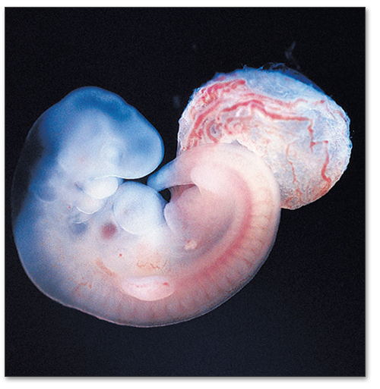
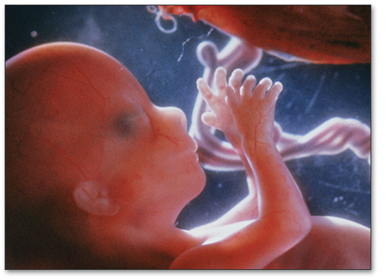
Prenatal Development
Germinal Period (Weeks 1-2)
  Conception
  Fertilization
  Zygote
Embryonic Period (Weeks 3-8)
  Differentiation of tissue
  Organ formation
Fetal Period (Months 2-9)
      development of functionality

Slide 18
Prenatal Development
Important Milestones:
  Week 12: circulatory system begins to function
  Week 16: movements felt by mother
  Week 20: eyebrow, eyelashes, scalp hair
  Weeks 22-28: age of viability (fetus can survive outside the womb)
  Weeks 22 and beyond: senses active; fetus can remember voices, music, tastes

Slide 19

Prenatal Development
Teratogens are agents that cause
birth defects
  Drugs
  Diseases
  Environmental Hazards
Effects of teratogens depend on…
  Timing of exposure
  Genetic characteristics
  Postnatal environment

Slide 20
Teratogens and Development
Environmental teratogens may be particularly detrimental, especially if pregnant women are not aware of them
Sometimes the effects of teratogens are not evident until later in life

Slide 21

General Risk Factors during Pregnancy
Nutrition
  A pregnant woman should increase both her caloric and nutrient intake
  eating for two now!
  Inadequate nutrition can lead to developmental disorders or miscarriage

Slide 22


General Risk Factors during Pregnancy
Prolonged Stress
  Stress can harm a fetus’ development
  Causes greater harm when experienced early during pregnancy
Women who report greater anxiety during pregnancy:
  More likely to give birth early or have babies who weigh less than average

Slide 23

The Newborn’s Reflexes (1)
Reflexes == unlearned responses that are triggered by specific stimuli.
Key points: Unlearned and situational; Automatic responses

Slide 24
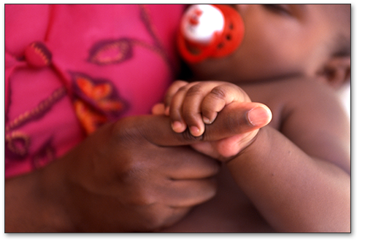
Natural-Born Reflexes
Some persist throughout life:
  coughing, blinking, yawning
Some disappear with
neurological development:
  grasping, rooting, moro reflex
There as Six reflexes that should be present at birth

Slide 25
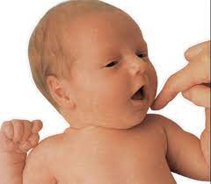
The Newborn’s Reflexes (3)
Rooting reflex
  Starts when the corner of the baby’s mouth is stroked or touched
  The baby will turn its head, open its mouth, and follow the direction of the stroking
  https://www.youtube.com/watch?v=b0CLcNtOOEQ
  Helps the baby with feeding
  Lasts until about 4 months old

Slide 26

The Newborn’s Reflexes
Suck reflex
  When the roof of a baby’s mouth is touched, it will start to suck
  Doesn’t develop until about the 32nd week of pregnancy; not fully developed until about 36 weeks
  Premature babies have a weak or immature sucking ability and may struggle to feed

Slide 27
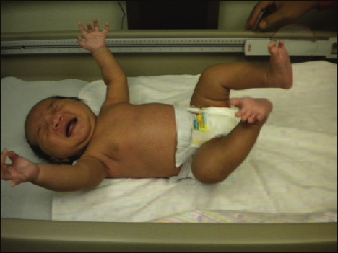
The Newborn’s Reflexes
Moro reflex (Startle Reflex)
  Occurs when a baby is startled by a loud sound or movement
  Baby throws back its head, extends arms, cries, and pulls legs/arms back in
  Lasts until the baby is about 2 months old
  https://www.youtube.com/watch?v=sD-Sw3mwDFk

Slide 28
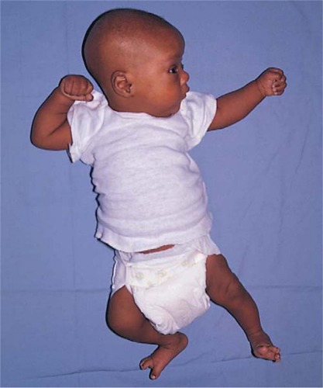
The Newborn’s Reflexes
Tonic neck reflex
  When a baby turns its head to one side, the arm on that side stretches out; opposite arm bends at the elbow
  Called the “fencing position”
  Lasts until the baby is about 5-7 months

Slide 29
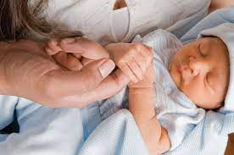
The Newborn’s Reflexes
Grasp reflex
  Touching or stroking the palm of a baby’s hand causes the baby to close its fingers in a grasp
  Lasts until the baby is about 5-6 months old
  The toes have a similar reflex lasting until the baby is 9-12 months old

Slide 30

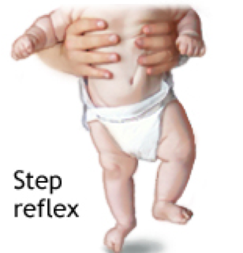
The Newborn’s Reflexes
Stepping reflex
  Also called the walking or dance reflex
  Occurs when a baby is held upright with its feet touching a solid surface
  https://www.youtube.com/watch?v=aJSVDy-8yV0

Slide 31
Why do babies have reflexes?
Certain reflexes have survival value.
  Example: Rooting, sucking
Other reflexes are developmental precursors to later voluntary motor behaviors.
  Example: stepping is a precursor to walking.
Reflexes reflect the health of the child’s nervous system.

Slide 32
Apgar Scores
The Apgar Score provides a quick assessment of a newborn’s health
Focuses primarily on body-systems required to sustain life.

Slide 33
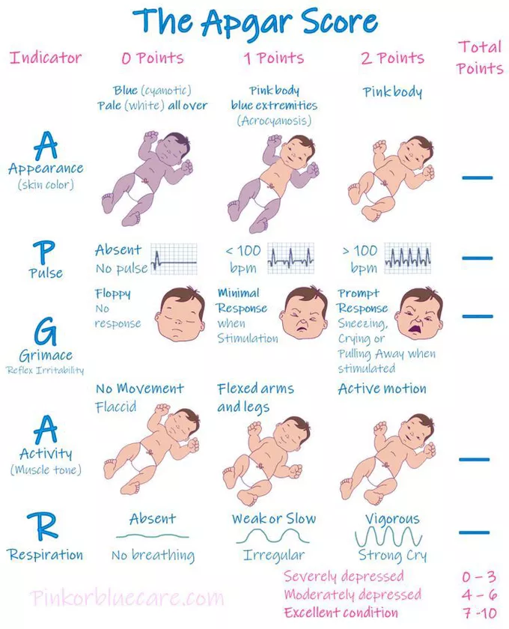

Slide 34
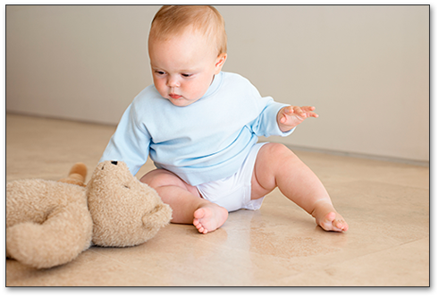
Physical and Motor Skill Development
Motor skill development
  Locomotion
  Reach & grasp
  Coordination
  Balance
  Increase in complexity
  as age increases
Preferential Looking
  Infants “look” at preferred
  objects and people

Slide 35
The Newborn’s States
Alert inactivity: calm; eyes open and attentive; deliberately inspecting environment
Waking activity: open but unfocused eyes; uncoordinated motions
Crying: cries vigorously; motion is agitated and uncoordinated
Sleeping: eyes closed; degree of activity and quality of breathing alternate

Slide 36
Crying
Basic cry
  Starts softly and builds in volume and intensity
  Often seen when the child is hungry
Mad cry
  More intense and louder
Pain cry
  Starts with a loud wail, followed by a long pause, then gasping

Slide 37

Sleeping
Newborns sleep an average of 16-18 hours per day. They spend the most time in this state.
Sleep cycles
  Newborns: 4-hour cycle; 3 hours sleep and 1 hour awake
  By 3-4 months: sleep for 5 to 6 hours straight
  By 6 months: sleep 10 to 12 hours at night
REM sleep
  50% of newborn sleep
  25% by 12 months

Slide 38
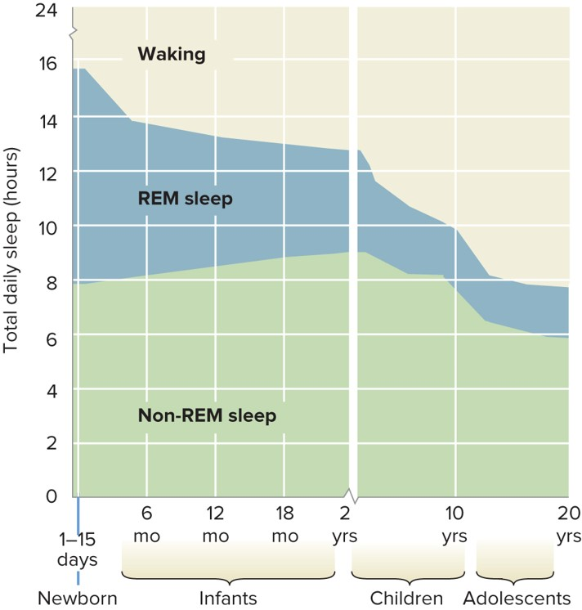

Slide 39
Cognitive Development
What is cognitive development?
  Refers to the development of cognitive processes, such as language, memory, perception, etc.
  Researchers interested in cognitive development seek to understand how children make sense of the world
  Key Question: How do these systems change and grow as the child ages?

Slide 40
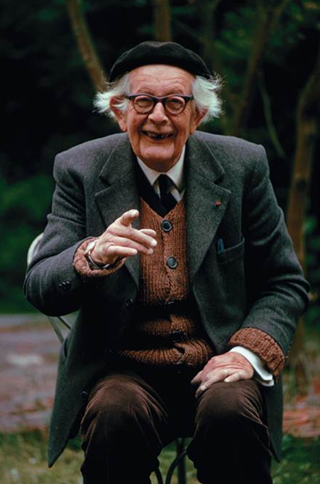
Cognitive Development
Jean Piaget (1896-1980) – Theory of Cognitive Development
  Children actively construct their cognitive world
    “Little Scientists”
2 Processes for Cognitive Development
  1.) Assimilation – Incorporate new information into existing knowledge
  2.) Accommodation - Adjust schemas in response to new information

Slide 41


Slide 42
How do schemes change? (1)
Assimilation: fitting new experiences into existing schemes
  Required to benefit from experience
  Example: Any furry animal with four legs is a dog

Slide 43
How do schemes change? (2)
Accommodation: modifying existing schemes as a result of new experiences
  Allows for dealing with completely new data or experiences
  Example: Adjusting a schema of “dog” to include subschemas like “cat”, “rabbit”, etc.

Slide 44

Piaget’s Theory
Sensorimotor Stage (birth - 2 years)
  Coordinate sensations with movements
  Object permanence – objects still exist even when they are not seen
  Progress from reflexive action to planned action

Slide 45
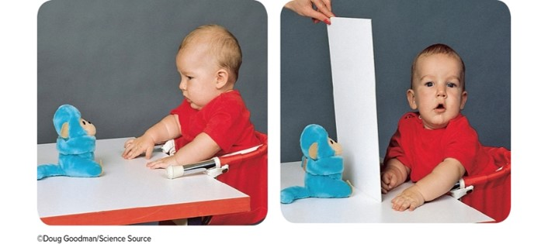
Object Permanence
  knowing an object still exists even if not in view
    No object permanence = “out of sight out of existence”
  According to Piaget, not fully understood until 18 months of age

Slide 46

Piaget’s Theory
Preoperational Stage (2 - 7 years)
  Symbolic/Abstract Thinking: Words & Images
  Intuitive Reasoning
  Egocentrism

Slide 47
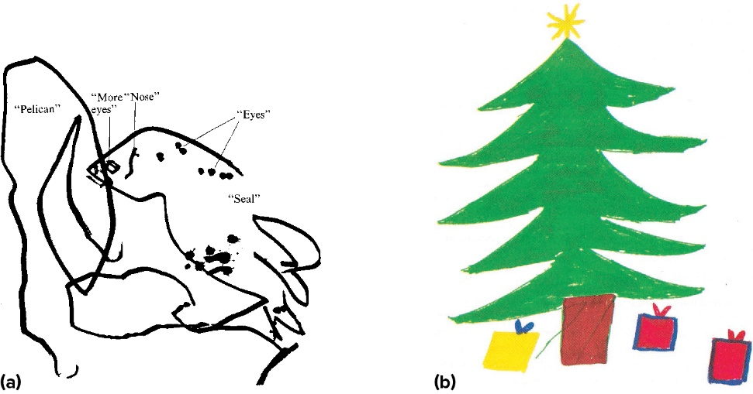
Preoperational Thinking
  Children represent the world with words, images, and drawings.

Slide 48
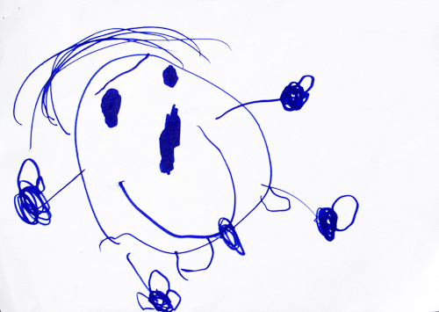



Children’s drawings of People

Slide 49
Preoperational Thinking
Egocentrism
  Difficulty seeing world from another’s perspective
Preoperational children have a hard time understanding that other people view the world differently than they do

Slide 50
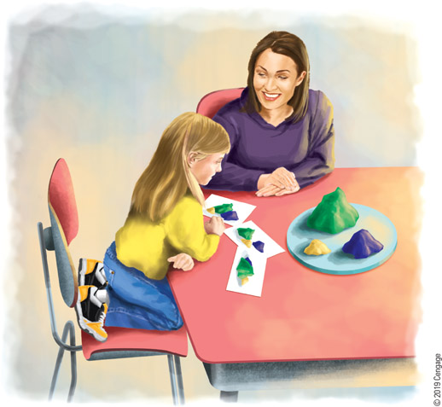

Slide 51

Appearance is Reality
Appearance is reality
  Assuming that an object is really what it appears to be (e.g., thinking that Shrek is a real ogre)

Slide 52

Piaget’s Theory
Concrete Operational Stage (7 – 11 yrs)
  Operational Thinking (e.g., conservation)
  Classification Skills
  Reason logically in concrete contexts
    i.e., Argument building

Slide 53

Piaget’s Theory
Formal Operational Stage (11-15 yrs)
  Lasts through adulthood
  Abstract and idealistic thought
  Hypothetical-deductive reasoning

Slide 54

Vygotsky’s Sociocultural Cognitive Theory
Cognitive development is a product of one’s culture and education
  Goal of cognitive development is to be competent in one’s culture
Apprentice-Expert Model
  Children learn by working closely with a knowledgeable other

Slide 55
Emotional Development
Temperament
  Dispositional way of responding to situations
3 Developmental Types in Children
  1.) Easy going – Adapts well to new experiences
  2.) Difficult – Reacts negatively and cries frequently
  3.) Slow-to-warm-up – Low energy, cautious

Slide 56
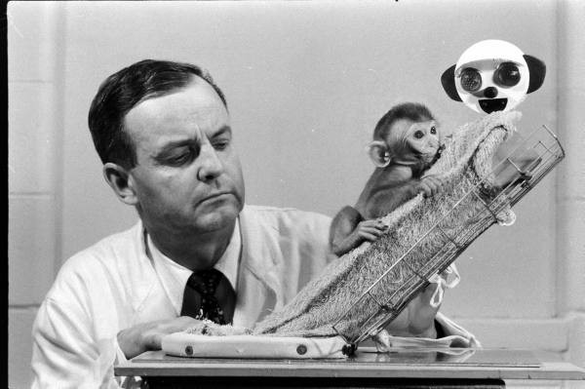
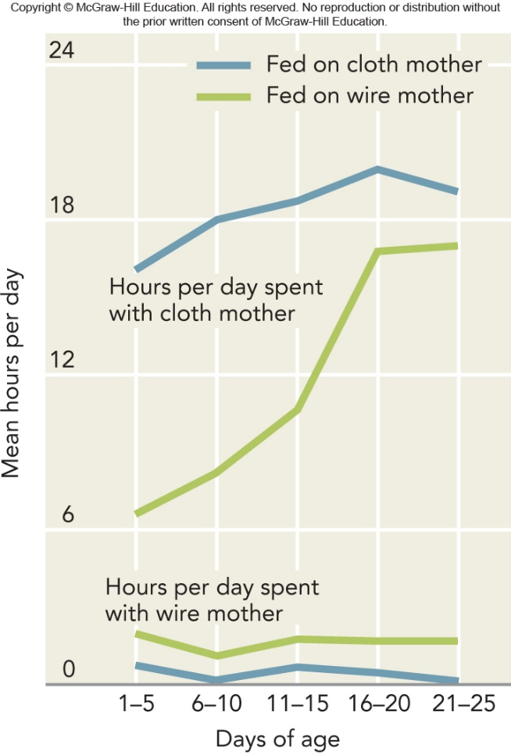
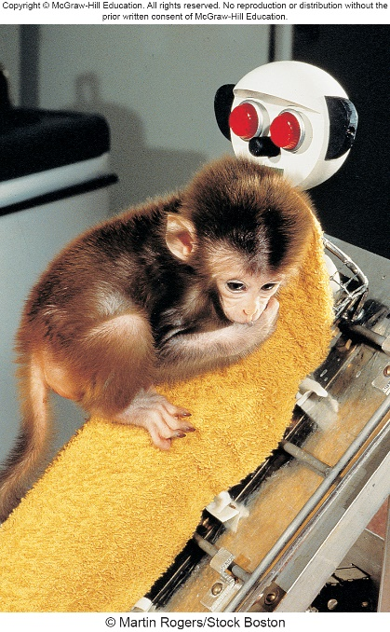
Attachment
Harry Harlow (1958)
  Examined attachment in Rhesus monkeys that were separated from their mothers at birth
Baby monkeys were placed in cages
with 2 fake mothers
  Wired mother
  Cloth mother

Slide 57
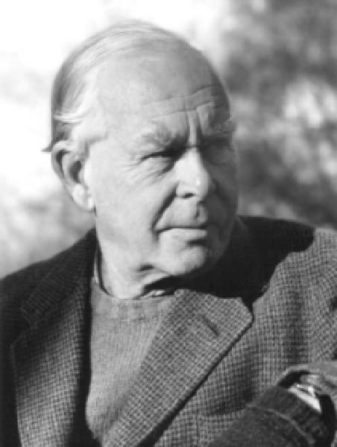
Attachment
John Bowlby (1907-1990)
Infant Attachment – Attachment between baby and caregiver
  Bowlby: Attachment with mother is innate
3 Attachment Styles
  Secure Attachment – Healthy attachment based on security
  Avoidant Attachment – Does not engage in attachment
  Anxious/Ambivalent – Very distressed when caregiver is absent

Slide 58
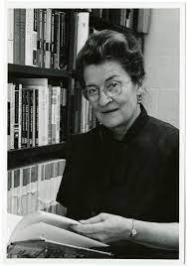
Forms of Attachment
Mary Ainsworth’s Strange Situation paradigm:
  Three phases (~3 minutes each)
    Child and mother first occupy an unfamiliar room filled with toys
    Mother leaves room momentarily
    Mother then returns to room
  Observe child’s reactions during each phase
  Classified four types of attachment
    Three insecure types; one secure

Slide 59
Four Types of Attachment Relationships
Secure attachment (60–65%):
  baby may or may not cry upon separation; wants to be with mom upon her return and stops crying
  Babies with this attachment type miss their mother but are happy when mother returns
  Understand that everything is okay

Slide 60
Four Types of Attachment Relationships
Avoidant attachment (20%):
  Baby not upset by separation; ignores or looks away when mom returns
  Type of insecure attachment
  Baby may be used to being left alone

Slide 61
Four Types of Attachment Relationships
Resistant attachment (10–15%):
  separation upsets baby; remains upset after mom’s return and is difficult to console
  Insecure attachment
  Baby may be angry at mother for leaving them

Slide 62
Four Types of Attachment Relationships
Disorganized attachment (5–10%):
  separation and return confuse the baby; reacts in contradictory ways (e.g., seeking proximity to the returned mom, but not looking at her)
  Insecure attachment
  Baby seems confused as to why mother left

Slide 63
What Determines Quality of Attachment?
Secure attachment results from predictable, sensitive, and responsive parenting
Why though?
  Relationships are most satisfying/beneficial when we can trust others and depend on them in times of need

Slide 64
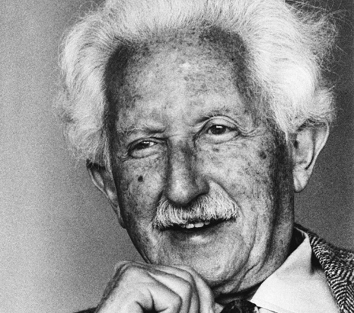
Erik Erikson (1902-1994)
Psychosocial Development
  Development is a lifelong process
  Not just a process during infancy or based upon a relationship with a caregiver
Proposed 8 stages of development
  4 stages in Infancy
  4 stages in Adolescence/Adulthood

Slide 65
Erikson’s Stages of Early Psychosocial Development
Each stage revolves around some sort of crisis that the child encounters during this period
  Each crisis is the catalyst for psychosocial growth
  Resolving a crisis establishes an area of psychosocial strength
What happens if a strength isn’t established?
  Psychosocial development is stunted

Slide 66


Psychosocial Theory of Development
First Four Stages: Childhood
  Stage 1: Trust vs. Mistrust
    basic needs met by sensitive caregivers
  Stage 2: Autonomy vs. Shame & Doubt
    discover and assert will of their own

Slide 67
Erikson’s Stages of Early Psychosocial Development
Basic Trust vs. Mistrust (Infancy)
  Trust in oneself and others is the foundation of human development
  Driven by parents responding to their infant’s needs
    Leads the infant to trust and feel secure in the world
    Mistrust is also important
  With a proper balance of trust and mistrust, infants can acquire hope
  Erickson defined hope as an openness to new experiences tempered by a wariness that danger may arise

Slide 68
Erikson’s Stages of Early Psychosocial Development
Autonomy vs. Shame and Doubt (1-3 years)
  As children grow, the gradually learn they can control their own actions
  Children strive for autonomy (independence form others)
    Doubt – can the child handle demanding situations?
    Shame – results from failure
  A blend of autonomy, shame, and doubt gives rise to will
    knowledge that within limits, kids can act on their world intentionally

Slide 69

Psychosocial Theory of Development
First Four Stages: Childhood
  Stage 3: Initiative vs. Guilt
    challenged to assume responsibility
  Stage 4: Industry vs. Inferiority
    mastering knowledge & intellectual
    skills

Slide 70
Erikson’s Stages of Early Psychosocial Development
Initiative vs. Guilt (3-5 years)
  Most 3- or 4-year-olds take some responsibility for themselves
    Example: Dressing themselves
  Start exploring the world around this time
    Ask questions, imagine future, etc.
  This combines into a sense of initiative

Slide 71

Psychosocial Theory of Development
Last Four Stages: Adulthood
  Stage 5: Identity vs. Identity Confusion
    Who am I & where am I going?
  Stage 6: Intimacy vs. Isolation
    Individuals form intimate relationships with others.

Slide 72
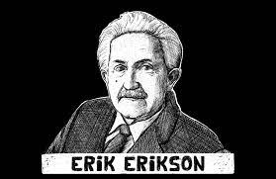
The Search for Identity
Erikson: identity vs. identify confusion
  Balancing between selecting a single self versus trying out many possible selves
Via formal operational thought they imagine themselves in various roles
“Finding yourself”

Slide 73

The Search for Identity
Strong focus on career roles
Also focus on talents, romance, friendships, religion, gender orientation
Adolescent thought becomes very self-oriented

Slide 74

Psychosocial Theory of Development
Last Four Stages: Adulthood
    Stage 7: Generativity vs. Stagnation
      Legacy: Assist younger generations

Slide 75

The Midlife Crisis
  How pervasive are midlife crises?
    The 40s are a decade of reassessing and recording truth about adolescent and adult years.
    Only a minority of adults experience a midlife crisis.

Slide 76
Life Transition in Midlife
Studies indicate that a midlife crisis is not a universal experience for middle-aged adults
  At best, individuals may face similar stresses, but transitions may occur at any time in adulthood
Midlife correction
  Reevaluating one’s roles and dreams and making the necessary adjustments

Slide 77
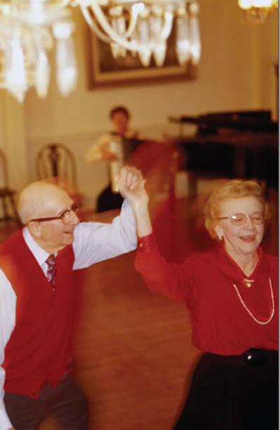
Psychosocial Theory of Development
Last Four Stages: Adulthood
    Stage 8: Integrity vs. Despair
      What have I done with my life?
    Making peace with one’s legacy

Slide 78
Moral Development
How do people develop ethics and to be prosocial?
Kohlberg’s Moral Development Theory (1958)
  3 Stages:
    1.) Preconventional – Reasoning due to reinforcements and punishments
    2.) Conventional – Standards learned from parents and societal laws
    3.) Postconventional – There can be a moral “gray area”; there are often many moral options, how do you choose the best one?

Slide 79

Adolescent Brain Development
Early Years
  Amygdala Development
    Emotions
Late Years
  Prefrontal cortex
    Reasoning and decision making
    Impulse control
    Attention

Slide 80

Adolescent Cognitive Development
Piaget’s Formal Operational Stage
  Adolescent Egocentrism
  Belief that others are as preoccupied with the adolescent as he or she
    They’re the “main character”
  Uniqueness
  Invincibility →
  risky behaviors

Slide 81

Adult Development and Aging
Development continues after adolescence!!!
Early Adulthood (20-35)
  Peak of physical development
Middle Adulthood (35-65)
  Decrease height, increase weight
  Hormone changes (e.g., menopause, late 40s or early 50s)
Late Adulthood (65+)
  Bodily wear and tear
  Reduced ability to repair and regenerate

Slide 82
Why do we age? - Theories
Cellular Theories
  Aging processes that occurs within individual cells
  Genetic and environmental influences
Programmed Aging Theory (Hayflick, 1965)
  “Hayflick Limit”
    Cells hardwired for a fixed number of divisions
    Cell death occurs when limit is reached
  Evidence: Telomeres – tips of chromosomes become shorter after each replication
  Problem: Even at death, most cells in human body divide very well, so if there is a limit, few cells reach it

Slide 83
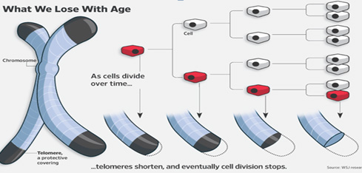

Slide 84
Why do we age? - Theories
Programmed Cell Death Theory
  Similar to Hayflick Limit, but different
  Innate ability of cells to self destruct or trigger processes in other cells in which cells die
  Assumed to be a genetic effect
Accumulation Theories
  Biochemical processes, like metabolism, leave residue (waste) that causes aging as it builds up
  E.g., Lipofuscin, insoluble fat/protein, a biomarker of aging
    Cross-linking proteins are also aging biomarkers

Slide 85
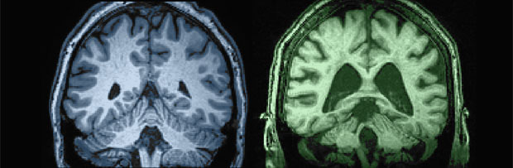
The Aging Brain
Brain decreases in neural density and size with increased age
  Reduction is fairly global, but tends to be greater in the prefrontal cortex (attentional/impulse control) and hippocampus (memory)
Some evidence for neurogenesis
  Olfactory bulb (smell) and hippocampus
Neural compensation – Areas of neural loss will shift to other areas of the brain
Reduced brain lateralization – Hemispheres show less specialized function

Slide 86

Age-Related Cognitive Changes
Early Adulthood
  Idealism gives way to realistic pragmatism.
  reflection on worldview
Middle Adulthood
  Memory peeks.
  Numerical ability
  declines.

Slide 87

Age-Related Cognitive Changes
Late Adulthood
  Decline in processing speed (neural action potential speed)
  Memory retrieval skills decline
  Increase in “wisdom”
  Increase in physical activities may ward off some cognitive declines, though not supported empirically (McDaniel et al., 2014)

Slide 88
Tips for Healthy Aging
1.) Maintain good nutrition and physical activity throughout the lifespan
  Moderate alcohol use, reduced fat intake, cardiovascular activities
2.) Engage in educationally stimulating careers/hobbies
3.) Stay socially active
4.) Get a good amount of sleep (8 hours minimum)
  Naps, siestas, etc.
5.) Minimize stress

